Slide 1

SURVEY ON CLOUD AUTHENTICATION USED BY SMEs
Department: Computer Science & Engineering
Institute: Chandigarh UniversityDepartment: Computer Science & Engineering
Institute: Chandigarh University
JEAVI KARWAL(24BCY70002)
VANSHDEEP SINGH (24BCY70033)
HARKUNWAR SINGH(24BCY70049)
MANYA SHARMA(24BCY70050)
AMITOZ SINGH(24BCY70071)
DISCOVER . LEARN . EMPOWER

Slide 2
TOPICS TO BE COVERED
Introduction
About Technology
Weekly Schedule
Certification Done
Conclusion and Future Scope
References

Slide 3
INTRODUCTION ABOUT TECHNOLOGY
Cloud Authentication Technology
Cloud authentication verifies user identity before providing access to cloud applications, data, and digital platforms used by SMEs.
SMEs rely heavily on digital tools like billing software, ERP, HR systems, and online payment apps — making authentication critical.
Authentication methods studied include:
✓ Password-based login
✓ OTP-based 2FA
✓ Multi-Factor Authentication (MFA) apps
✓ Biometric authentication
✓ Passwordless systems
The survey helps understand which authentication techniques SMEs currently use, and what challenges they face in securing access.

Slide 4
WEEKLY SCHEDULE
WEEK 1 – Research & Survey Design
Studied authentication practices
Identified SME challenges
Prepared questionnaire
WEEK 2 – Data Collection
Approached SMEs from retail, manufacturing, service & education
Collected responses via Google Forms and direct interaction
WEEK 3 – Data Analysis & Visualization
Categorized authentication types used
Created charts: password usage, MFA usage, biometric usage
Identified common vulnerabilities
WEEK 4 – Documentation & Report Finalization
Compiled analysis
Prepared diagrams and graphical abstract
Completed final report & PPT

Slide 5
CERTIFICATION DONE
Google Cybersecurity Certificate
Covered fundamentals of cybersecurity
Learned password security, MFA, and authentication concepts
Understood cyber threats faced by SMEs
Strengthened knowledge for the project on authentication

Slide 6
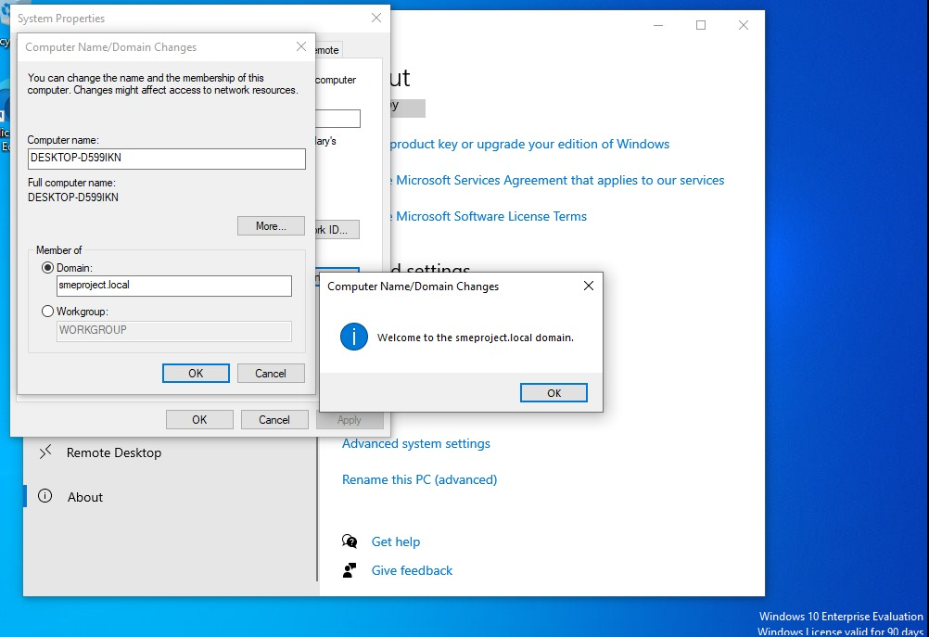
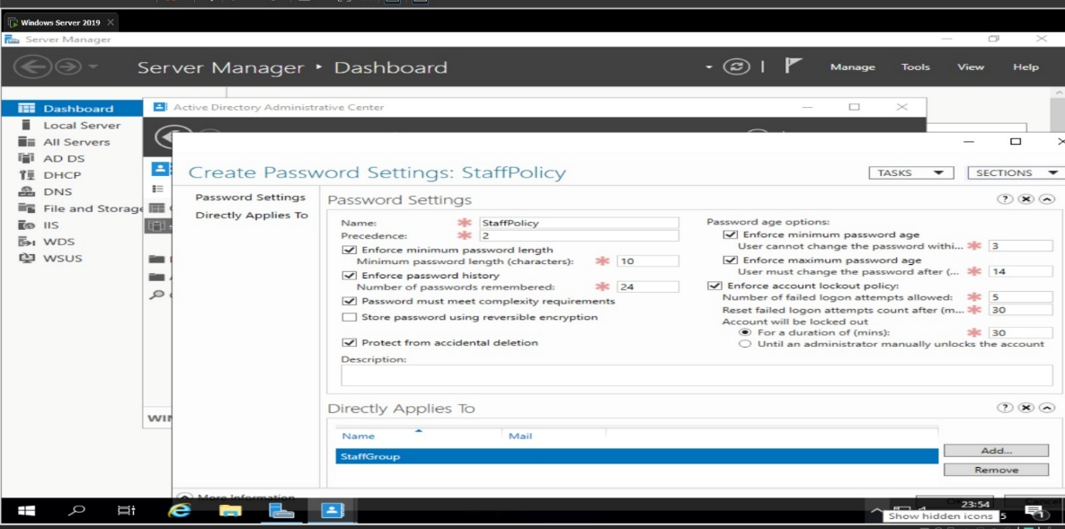
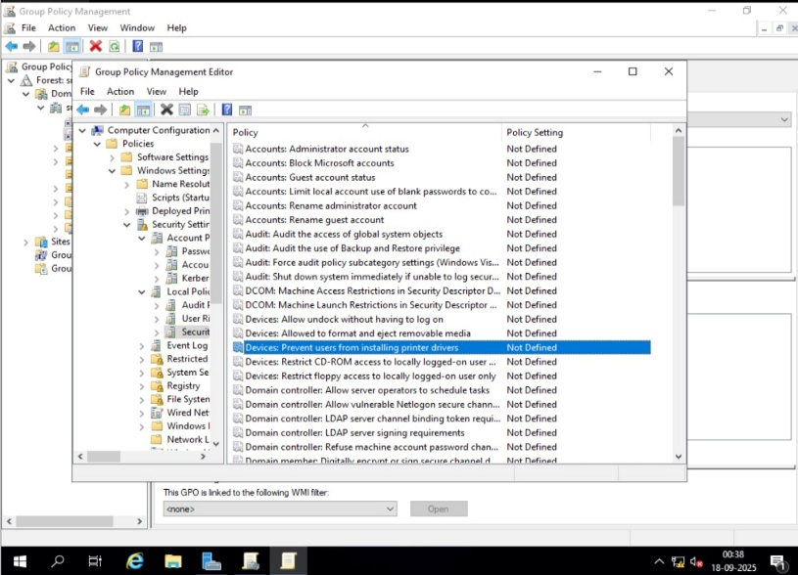
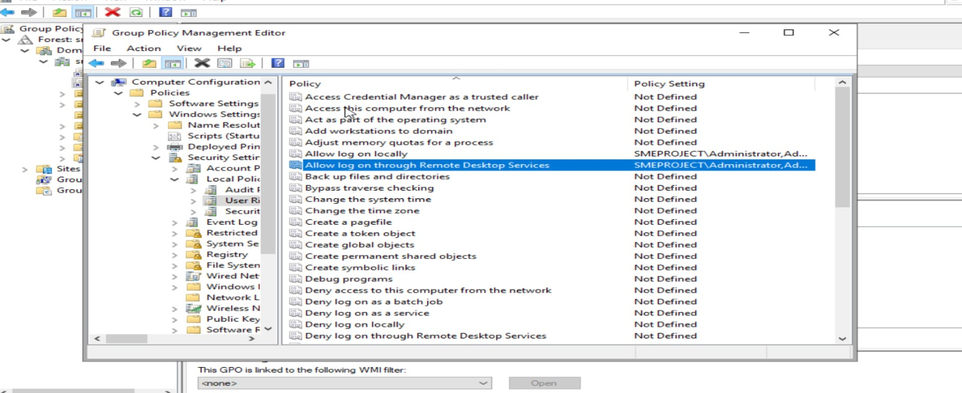

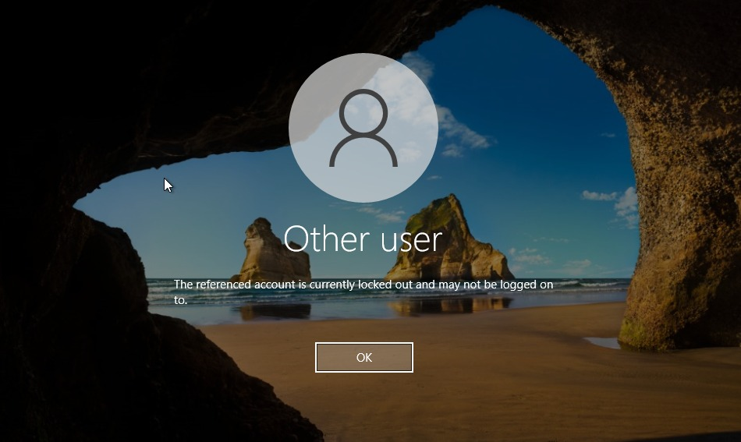
SCREENSHOTS

Slide 7
CONCLUSION
Password-based authentication is still the most commonly used method in SMEs.
MFA adoption is low due to lack of awareness, cost, and technical challenges.
Password sharing and weak password practices are major risks.
Biometric and passwordless systems show potential but lack adoption in small enterprises.
SMEs need awareness training, stronger policies, and simplified MFA solutions.

Slide 8
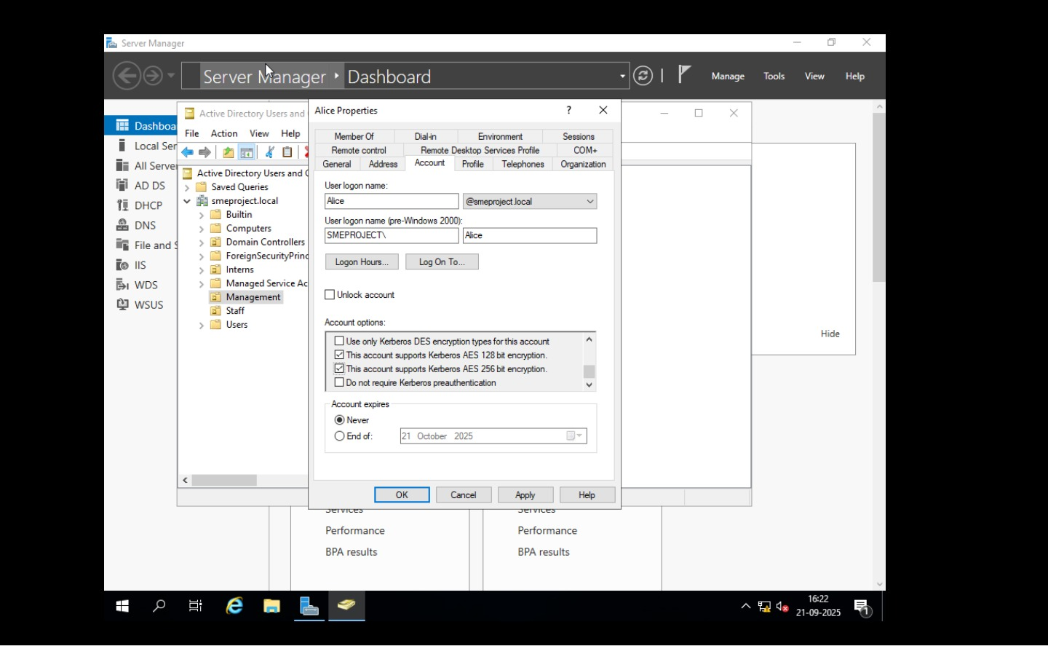
FUTURE SCOPE
Promote low-cost MFA adoption (Google Authenticator, Microsoft Authenticator).
Encourage SMEs to implement password policies and regular audits.
Introduce biometric and passwordless authentication gradually.
Conduct workshops to train employees about secure login practices.
Expand survey to a larger sample for more accurate national-level insights.

Slide 9
References
NIST Digital Identity Guidelines
IBM Data Breach Report 2023
Microsoft Digital Defense Report
ENISA Cybersecurity Guide for SMEs
Research papers from IEEE, Springer, ACM
SME Cybersecurity Studies and reports

Slide 10
THANK YOU

